Slide 1

Through a Hacker’s Eyes: The Hunt for Vulnerabilities
Mitch Schmidt

Slide 2
What are we talking about?
[News and Notes]
What is a vulnerability?
Why and how would a hacker use it?
Gimme some examples!

Slide 3
News & Notes
BSides Orlando, April 8th
N0l3ptr is a top 150 team, 7th ranked academic team in the U.S.
Many CTFs coming up, including Volga this weekend!

Slide 4
So… What is a vulnerability?
Weakness in an information system, system security procedures, internal controls, or implementation that could be exploited or triggered by a threat source.¹
I.e. a flaw that could allow an attacker to gain more access than expected
Nothing necessarily technical about it!

Slide 5
What do hackers do with these? Exploits!
A piece of software, a chunk of data, or a sequence of commands that takes advantage of a bug or vulnerability in order to cause unintended or unanticipated behavior to occur on computer software, hardware, or something electronic (usually computerized).
Not necessarily software!

Slide 6
To What End?
Remember CIA!⁴
Confidentiality - keep secret data secret
Integrity - make sure nothing funky happens with the data
Availability - make sure product is accessible!!!
Windows - gain “admin” privileges
Linux - gain “root” privileges
Both are “superusers” who can change files, directories, and system information for other users

Slide 7
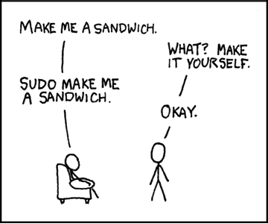
https://xkcd.com/149/

Slide 8
How do hackers do this?
Privilege Escalation!
It almost always takes a series of exploits to increase your privileges from a user to a superuser
Exploit Kits - automatically detect vulnerabilities and sends an exploit that gives them access to the computer
Vulnerability Databases -

Slide 9
But Why Male Models?
Step 1: Hack people’s computers
Step 2: ???
Step 3: Profit!
??? can be selling vulnerabilities on the black market, ransomware (taking computers hostage), stealing personal data, adware, spyware, creating a botnet, and many more ways

Slide 10
What kinds of vulnerabilities are out there?
Software Vulnerabilities - vulns in code of regular programs allowing escape
Hardware Vulnerabilities - vulns caused by hardware issues
Implementation Vulnerabilities - vulns caused by bad/incorrect implementations of known protocols or algorithms

Slide 11
Protocol Vulnerabilities - Vulns caused by a protocol itself being vulnerable
Kernel Vulnerabilities - Subset of software vulns, but allow a program executed as a user to get kernel-level access
Stupid/Lazy Programming/Admin - Problems often arise here
Most vulnerable: Users!
These are not all mutually exclusive or all inclusive!

Slide 12
How can users be vulnerable?
Social Engineering
Phishing - campaigns often have >100% success rate (from penetration tests)
Used to harvest credentials from users being sent to
It is possible to spoof email addresses
Great campaigns can be forwarded onto other users, gaining more credentials

Slide 13
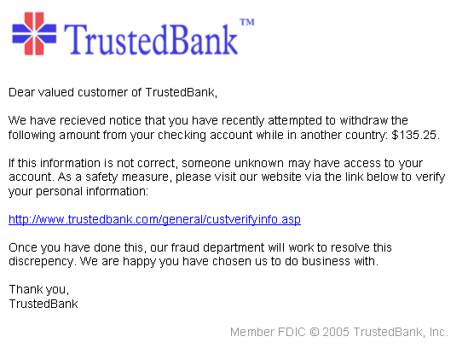
https://en.wikipedia.org/wiki/Phishing#/media/File:PhishingTrustedBank.png

Slide 14
More on Phishing
Must pay attention to URL - not just subdomain, but also domain
“Green Lock” - doesn’t mean much security-wise, just that the certificate is valid
Doesn’t guarantee the site is secure/valid
Can also have malicious attachments, allowing code execution on your computer
These often download/execute ??? (from slide 9)

Slide 15
Even More on Phishing
Once a user’s credentials are harvested hackers have access to inner network, applications, data, etc.
If companies do not assume malicious users can access inner domain, widespread mayhem can occur
Often they will have both internal and external apps tested during penetration tests
Companies are increasingly being targeted by ransomware²

Slide 16
Even Even More on Phishing
When regular users (not companies) are attacked in a campaign, usually personal data such as passwords or credit cards are the target
Users targeted in more of a “shotgun” approach
SSNs, credit card numbers, DOB all have value on the black market³

Slide 17
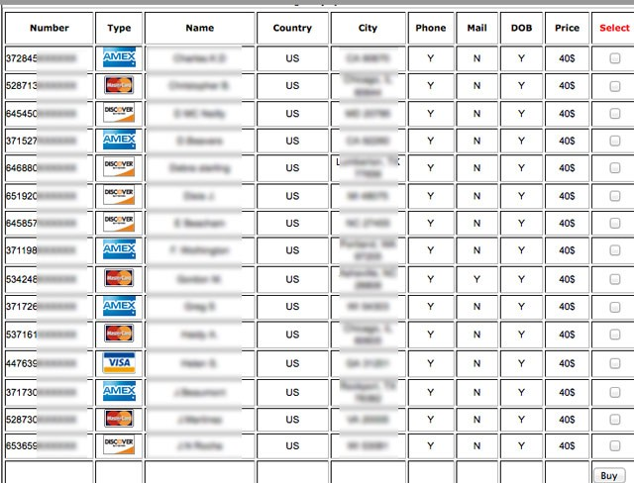
https://www.linkedin.com/pulse/20140822165720-1094155-stolen-credit-cards-and-the-black-market-how-the-digital-underground-works

Slide 18
Other Social Engineering tactics
Customer service - they are (usually) human, so they can let emotions get in the way of secure practices
https://www.youtube.com/watch?v=lc7scxvKQOo
Credit Card Skimmers
http://www.pcmag.com/article2/0,2817,2469560,00.asp
Fake ATMs
https://krebsonsecurity.com/2013/12/the-biggest-skimmers-of-all-fake-atms/

Slide 19
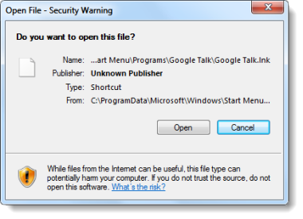
Stupid/Lazy Admin
Windows (particularly Vista) - too many security popups cause users to ignore or turn off warnings
Running services with
superuser account

Slide 20
Stupid/Lazy Admin
Most common: poor access control
Principle of Least Privilege⁵
Users should not be given sudo access unless they need it, and only for programs they need
If a hacker gains access to such a user, it is as good as owned
Storing plaintext passwords
Unnecessary services running, esp with weak creds (IoT)
Lack of TSL

Slide 21
Implementation Vulnerabilities
Most common on the web: OWASP top 10⁶
SQL injection
Weak session management
Cross Site Scripting (XSS)
Heartbleed⁷ Bug - certain implementations of SSL allowed attackers to read memory of systems
SSL is fine, but the implementation itself left servers open to attack
Databases are vuln goldmines

Slide 22
Implementation Vuln Mitigation
Patch, patch, patch!
Make sure you are on e-mail lists for critical software
Make sure your applications follow secure coding practices (and that you know what they are)

Slide 23
Software Vulnerabilities
Buffer overflow vulnerabilities⁸
When a program allows more data to be written into a buffer than it can hold, it overflows into other data
Format String vulnerabilities⁹
In the C printf function, invalid input can cause data leaks and crashing of the program
Heap Overflow Vulnerabilities & Use-After-Free¹⁰
Heap-based vulnerabilities caused by incorrect pointer handling
Integer Overflow
Incorrect casting of data (long -> short or unsigned -> signed) can mess up control flow

Slide 24
Software Vulnerabilities
Those ones are easier to detect, if your program segfaults with unsuspected input it is probably vulnerable
Use secure coding practices
Never roll your own crypto

Slide 25
More Software Vulnerabilities
Race Conditions
Shouldn’t be able to write to data twice at the same time, or write and read at the same time
Timing Attacks
If you can time how long it takes to do something with different exit conditions, can figure out certain aspects of the data
Example: String comparisons check letter by letter

Slide 26
Hardware Vulnerabilities
Usually harder to prevent
Unexpected physical access to devices
I.e. unauthorized person gaining access to usb drive or power button/keyboard
Rohammer Bug¹⁰
Attacked DRAM by performing certain memory access operations, allowing adjacent addresses to be read/written to, even with proper perms

Slide 27
Hardware Vulnerabilities
IoT Lack of Entropy
Leads to weak keys -> weak crypto
Hard Drive Security
Can be difficult to truly erase data, as physical magnetic data may remain
Spyware that targets the hard drive firmware¹¹
Hardware must interact with software (with drivers and firmware) so there is always a chance this could be exploited or hijacked

Slide 28
Protocol Vulnerabilities
Sometimes widely used protocols are vulnerable (some more: SSL, DNS, others with no transport layer security
WEP
Old WIFI protocol still in use some today
Can be easily cracked to give an attacker access to all web traffic going to the router¹²
ARP
Protocol used to connect physical and network addresses
ARP Cache Poisoning allows arbitrary control of packets on a subnet

Slide 29
Kernel Vulnerabilities
The Kernel is a program that controls how your operating system runs
Therefore, it is just a program like any other and can have mistakes in it too
List of linux kernel exploits¹³
Kernel Vulns are especially dangerous because exploits usually garner superuser access
Dirty Cow¹⁴ - A race condition in the kernel allowed for privilege escalation

Slide 30
Sources
http://nvlpubs.nist.gov/nistpubs/ir/2013/NIST.IR.7298r2.pdf
https://krebsonsecurity.com/2016/09/ransomware-getting-more-targeted-expensive/
http://www.bankrate.com/finance/credit/what-your-identity-is-worth-on-black-market.aspx
http://whatis.techtarget.com/definition/Confidentiality-integrity-and-availability-CIA
https://en.wikipedia.org/wiki/Principle_of_least_privilege
https://www.owasp.org/index.php/OWASP_Top_Ten_Cheat_Sheet
http://heartbleed.com/
https://www.owasp.org/index.php/Buffer_Overflow
https://www.owasp.org/index.php/Format_string_attack

Slide 31
Sources 2
https://www.blackhat.com/docs/us-15/materials/us-15-Seaborn-Exploiting-The-DRAM-Rowhammer-Bug-To-Gain-Kernel-Privileges.pdf
http://mashable.com/2015/02/17/equation-group-what-to-do/#9ROsvPAQXsqu
https://www.aircrack-ng.org/doku.php?id=simple_wep_crack
https://www.cvedetails.com/vulnerability-list/vendor_id-33/product_id-47/cvssscoremin-7/cvssscoremax-7.99/Linux-Linux-Kernel.html
https://dirtycow.ninja/

